Slide 1
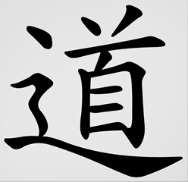
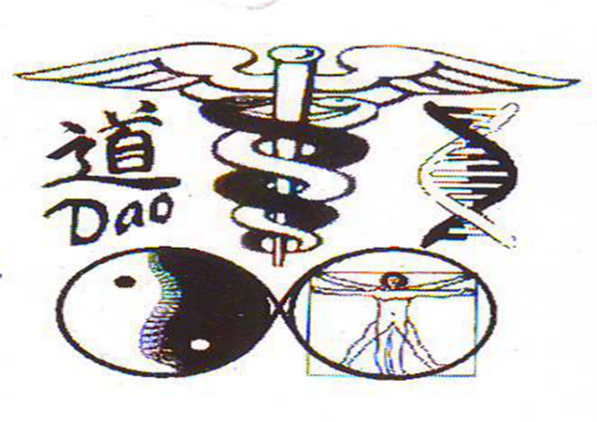
You tube-yin yang explained 01- What is Daoism/ Taoism?
DAO / TAO (the WAY)?
Universal language. universal law. universal answer.
* The ultimate unifying theory (yin) and practice (yang) of everything.
* This includes the origin of the universe (big bang), medical, scientific,
philosophical and spiritual advancement past, present and future.
* The answer to the mystery of health, wealth and happiness.
Dao means “ the way”. The way in which the
universe and everything within it
( the ten thousand things/ ten thousand beings)
work together in harmony and in accordance
with the laws of nature.
It is a philosophy and not a religion.
The core concept is simplicity.
Dr. Massih Yaghmai
BSc (Hons), ATCM, ND, MRN, RCST, LCSP
www.acupuncture4u.co
you tube: yin yang explained 01
email: massihya@yahoo.co.uk
Copyright © 1986 { Dr. MASSIH YAGHMAI }. All Rights Reserved.

Slide 2
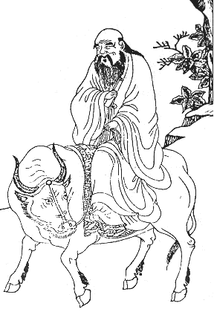
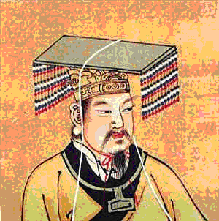
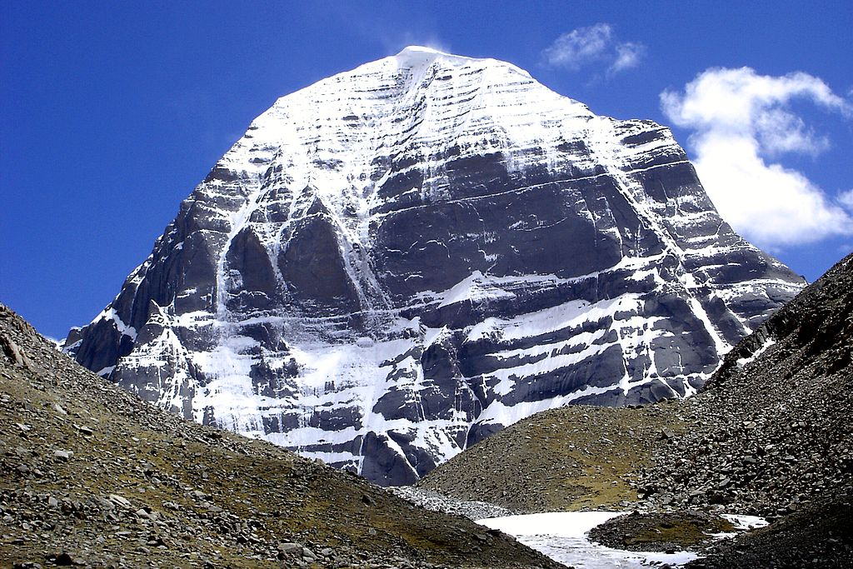
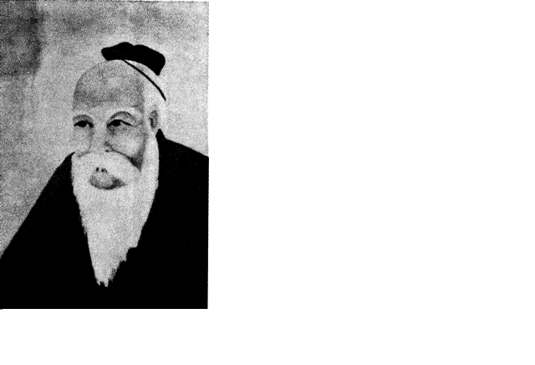
You tube-yin yang explained 01- The founder of Daoism
LAO TSE/ LAO TZU
HUANG-DI NEIJING SUWEN or
The Yellow Emperor’s Classic of
Internal medicine.
MOUNT KAILASH
Copyright © 1986 { Dr.MASSIH YAGHMAI}. All Rights Reserved.

Slide 3
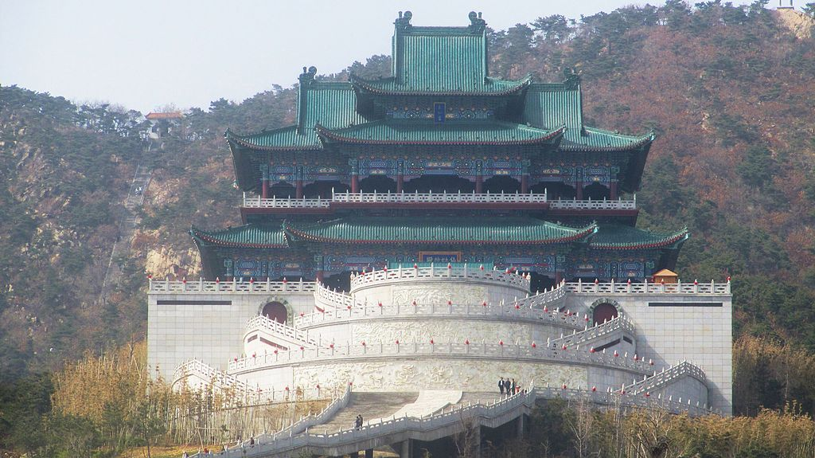
You tube-yin yang explained 01- Daoist temple
The Dao pours out everything into life,
It is a cornucopia that never runs dry.
It is the deep source of everything, It is nothing
yet it is everything.
It smooth round sharpness and untangles the
knot.
It glows like the lamp that draws the moth.
Dao exists, Dao is and Dao will be.
But where it came from I do not know.
It has been shaping things from before the
First Being,
From before the beginning of time (before the big bang).
Xianguting temple in Weihai, Shandong, China
Copyright © 1986 { Dr. MASSIH YAGHMAI }. All Rights Reserved.

Slide 4
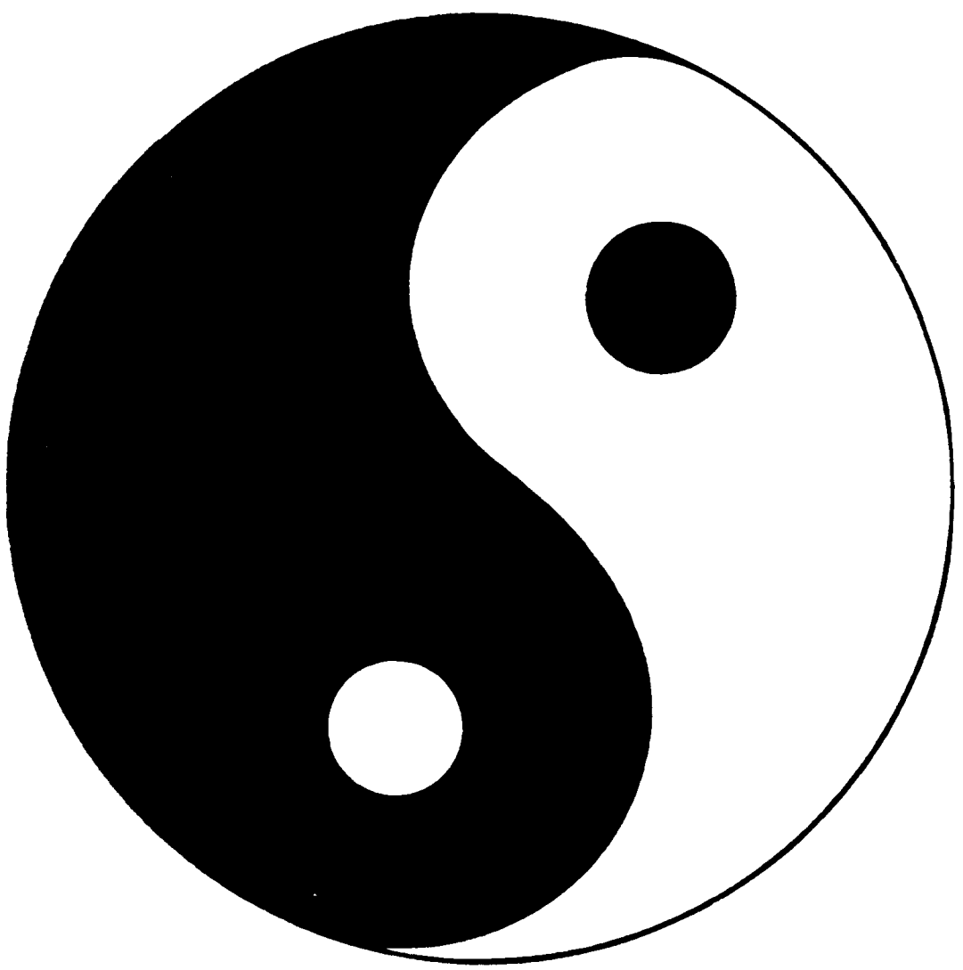
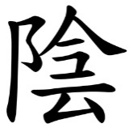
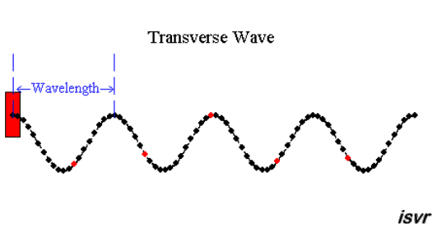
Youtube: yin yang explained 01- active YIN + YANG
YANG
YIN
Copyright © 1986 { Dr. MASSIH YAGHMAI}. All Rights Reserved.

Slide 5
Youtube: yin yang explained 01- Some examples of Dao/Tao
YIN
YANG
The moon.
Female.
Cold.
Water. Alkaline
Patience (slowly).
To be (mindful), to rest
De-flamed? / soothed.
Let go /surrender/accept
Death.
Dis-ease.
Emotion.
Not to be.
Uncertainty.
Chaos / dis-order
Illogical.
Feelings in the heart.
Confusion.
Nature. * Nurture.
Theory. * Practice.
Assertion. * Aggression.
The sun.
Male.
Hot.
Fire. Acid
Quick fix. Impatient.
To do, active. overload
Inflammation/ burnout.
.To control.
Life.
Health/ ease.
Motion.
To be.
Certainty.
Order.
Logical.
Thoughts in the head.
Clarity.
Copyright © 1986 { Dr. MASSIH YAGHMAI }. All Rights Reserved.

Slide 6
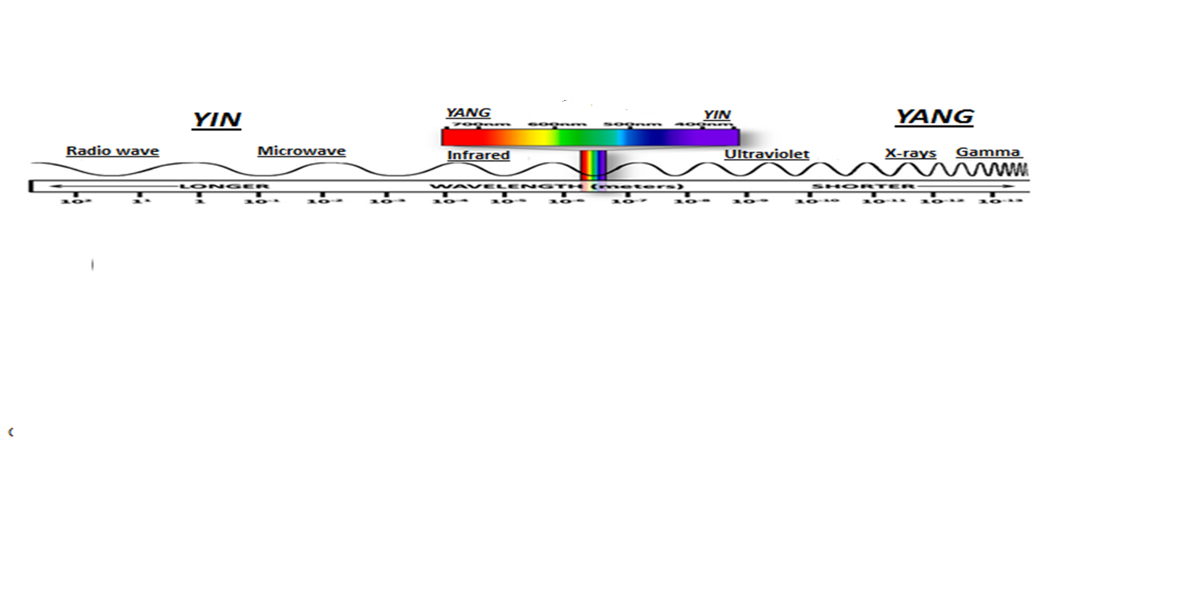
Youtube: yin yang explained 01-DAO of SOUND and LIGHT
VISIBLE LIGHT
SOUND
RADIOWAVE MICROWAVE
X-RAYS GAMMA RAYS
Copyright © 1986 { Dr. MASSIH YAGHMAI }. All Rights Reserved.

Slide 7
Youtube: yin yang explained 01-DAO and COMPUTERS
A 01000001 a 01100001
B 01000010 b 01100010
C 01000011 c 01100011
ON = YANG / 1
OFF = YIN / 0
Copyright © 1986 { Dr. MASSIH YAGHMAI }. All Rights Reserved.

Slide 8
Youtube; yin yang explained 01-Dao and Electricity= 50 cycles per second/ Alternating current
YANG
YIN
Copyright © 1986 { Dr. MASSIH YAGHMAI }. All Rights Reserved.

Slide 9
Youtube: yin yang explained 01-the Dao of true health at the PERSONAL level
We exist simultaneously in 3 universes.
Universe 1= YANG/BODY
Universe 2= YIN/MIND/EMOTIONS and
Universe 3= SOUL/SPIRIT/ FAITH
BODY/PHYSICAL/ YANG
Even flow, harmonious &
un-blocked flow of
the TRINITY of DAOISM
SPIRIT/SOUL/FAITH/CHI,QI,ENERGY
MIND/ EMOTIONS/ YIN
YANG
YIN
Copyright © 1986 { Dr. MASSIH YAGHMAI }. All Rights Reserved.

Slide 10
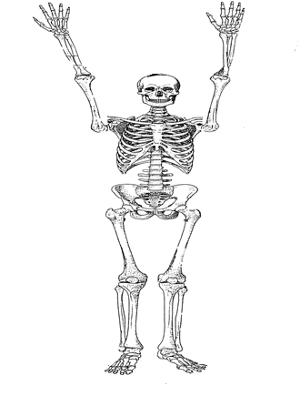
You tube- yin yang explained 01- The trinity of DaoThe posision of human in the universe
YIN/EARTH YANG/HEAVEN CHI/ ENERGY/MAN
+
=
HEAVEN (TIAN)
STAR DUST
MAN
REN
EARTH (DE)
Copyright © 1986 { Dr. MASSIH YAGHMAI}. All Rights Reserved.

Slide 11
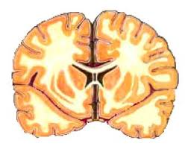
Youtube: yin yang explained 01-TRINITY of DAO and the BRAIN
YANG= right side of human brain is party, robotic, logical and a computer.
YIN= left side of human brain is partly emotional and feeling.
QI, CHI= combination of Yin and Yang of human brain is energy, spirit, soul and faith.
QI, ENERGY
YANG
YIN
Copyright © 1986 { Dr. MASSIH YAGHMAI}. All Rights Reserved.

Slide 12
You tube- yin yang explained 01- The trinity od Dao compared to a building
YANG/ BODY/PHYSICAL/CONSCIOUSNESS
DAO/TAO
YIN/MIND/EMOTIONS/ SUB-CONSCIOUSNESS
CHI /QI/ SPIRIT/ SOUL/GOD/DAO- CONSCIOUSNESS
Copyright © 1986 { Dr. MASSIH YAGHMAI}. All Rights Reserved.

Slide 13
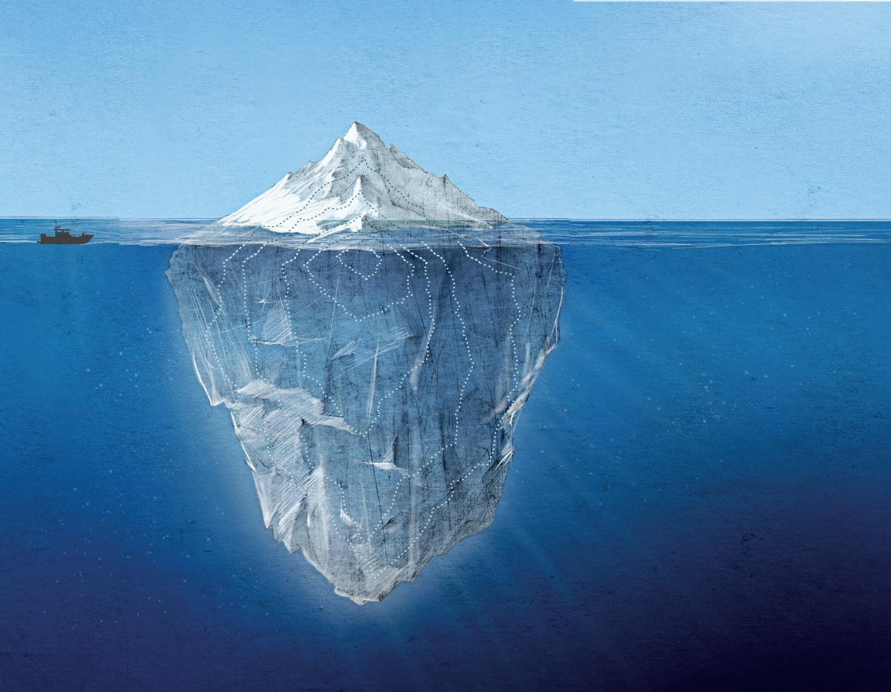
You tube- yin yang explained 01- The trinity of Dao compared to an iceberg
Yang/physical/consciousness
Yin/mind/emotions
Sub-consciousness
Qi/ chi/
God-consciousness
Copyright © 1986 { Dr. MASSIH YAGHMAI}. All Rights Reserved.

Slide 14
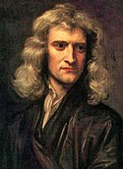
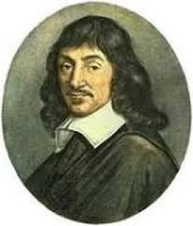
You tube- yin yang explained 01- The scientific and spiritual view of existence
Sir Isaac Newton
Rene Descartes
The MATERIAL / MATERIALISTIC / YANG VIEW:
Sir Isaac Newton (1642-1727) & Philosophical ideas of Rene Descartes (1596-1650).
* I think, therefore I am OR I am, therefore I think
The VITALISM / HUMANUSTIC / YIN VIEW
/ VITAL FORCE / VITAL ENERGY/
/ DIVINE INTELLIGENCE.
/ UNIVERSAL ENERGY.
/ I feel, therefore, I am. OR I am, therefore, I feel.
Rene Descartes
Copyright © 1986 { Dr. MASSIH YAGHMAI }. All Rights Reserved.

Slide 15
Youtube: yin yang explained 01-the Dao of true health at the PERSONAL level
BODY/PHYSICAL/ YANG
Even flow, harmonious &
un-blocked flow of
the TRINITY of DAOISM
YANG
SPIRIT/SOUL/FAITH/CHI,QI,ENERGY
MIND/ EMOTIONS/ YIN
YANG
YIN
Copyright © 1986 { Dr. MASSIH YAGHMAI }. All Rights Reserved.

Slide 16
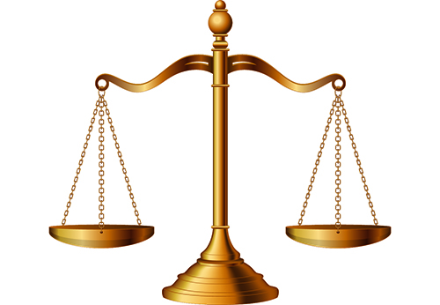
Copyright © 1986 { Dr. MASSIH YAGHMAI }. All Rights Reserved.
Youtube: yin yang explained 01-the Dao of true health at the CELLULAR level
METABOLISM/ CHI, QI, ENERGY
YANG
YIN
CATABOLISM/ YIN
(Food, air, water breakdown)
ANABOLISM/ YANG
(individual build up)

Slide 17
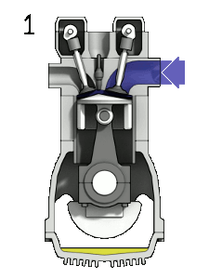
Copyright © 1986 { Dr. MASSIH YAGHMAI }. All Rights Reserved.
Youtube: yin yang explained 01-Trinity of Dao, Cellular engine.
FOOD, WATER, AIR
YANG
HEAT, TOXINS
YIN
YIN and YANG combination= CHI,QI, ENERGY
YANG
YIN

Slide 18
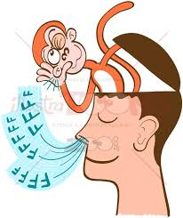
Youtube: yin yang explained 01-CLUTTERED MIND
YIN/ MINDFULL/ TO BE is LOST
YANG / TO DO / MONKEY MIND/ GRASSHOPPER/ CLUTTER
MODERN LIFE, COMPUTERS and INTERNET has
CREATED TOO MUCH YANG / CLUTTER/ IMBALANCE
Of YIN, YANG, CHI= SUFFERING.
Copyright © 1986 { Dr. MASSIH YAGHMAI }. All Rights Reserved.

Slide 19
You tube- yin yang explained 01- The trinity od Dao and the 5-pillars of health
YANG,BODY,
PHYSICAL
CHI, QI,
ENERGY,SPIRIT,
SOUL,FAITH
YIN,MIND,
EMOTIONS
1
2
3
4
5
Copyright © 1986 { Dr. MASSIH YAGHMAI }. All Rights Reserved.

Slide 20
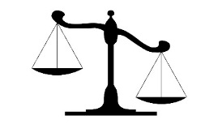
Youtube-yin yang explained 01-DAO and DIS-EASE.
BLOCKED
IMBALANCED
YIN
YANG
YANG
YIN
Copyright © 1986 { Dr. MASSIH YAGHMAI }. All Rights Reserved.

Slide 21
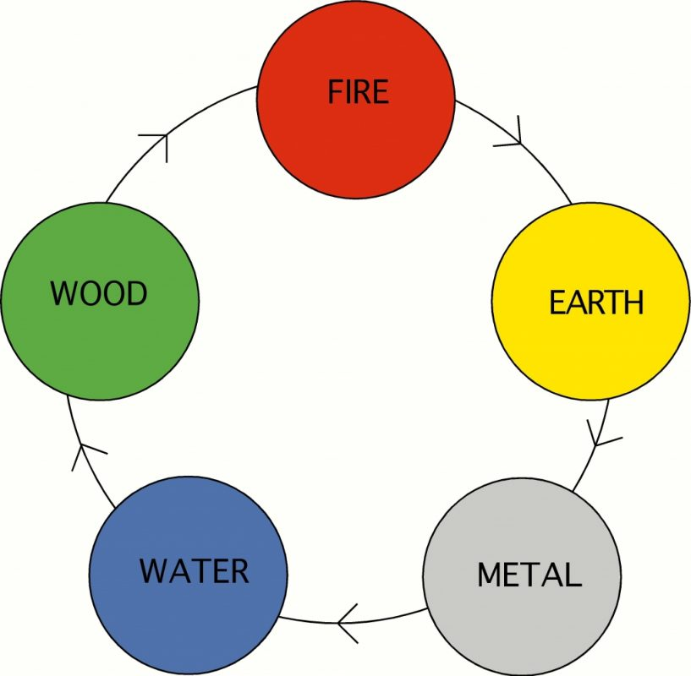
You tube-yin yang explained 01-trinity of Dao, 5-pillars of true health and acupuncture 5 elements
FIRE= Heart, Small Intestine, Pericardium, Three Heater.
EARTH= Stomach, Spleen.
METAL= Lungs, Large Intestine.
WATER= Kidney, Bladder.
WOOD= Liver, Gall Bladder.
Copyright © 1986 { Dr. MASSIH YAGHMAI }. All Rights Reserved.

